Slide 1
SALESFORCE INTEGRATION WITH EXTERNAL SYSTEM
Learn about MOST POWERFUL API: REST API,SOAP API, STREAMING API, BULK API

Slide 2
What are we going to learn in this course?
Salesforce APIs
Bulk API in Salesforce
Consuming External Services via Apex Callouts
Calling External Webservice from Lightning Web Components
Streaming API- PushTopics, Platform Events, Change Data Capture
Calling External Webservice from Aura Components
Fetching Data from Salesforce via External System
Sending Data from Salesforce to Java Application using Streaming API

Slide 3
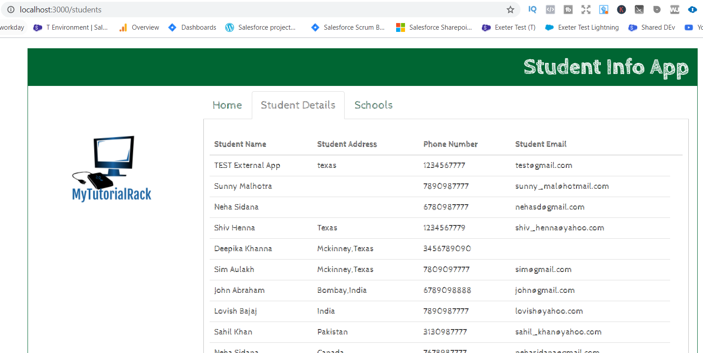
Student Info Application: fetch Salesforce Data

Slide 4
Upload Data into Salesforce using BULK API
We will learn about BULK API in the course, and using the BULK API we will insert records into SALESFORCE.
We will see how to insert records via a CSV file using Bulk API.
Execute bulk call using POSTMAN.

Slide 5
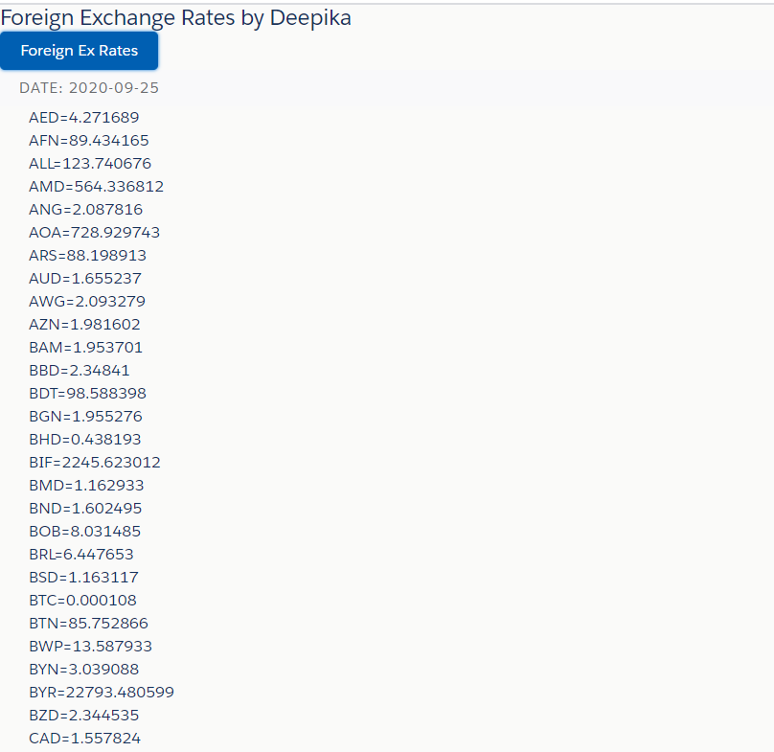
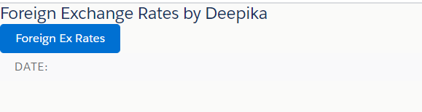
CALL external Webservice from Salesforce

Slide 6
Streaming API in Salesforce: Passing data from Salesforce to External System
SALESFORCE
Platform Events
JAVA APPLICATION
Push Topic
Change Data Capture

Slide 7
Integrating One Salesforce Org to Another Salesforce Org Using SOAP API
Salesforce Org -1
SOURCE ORG
Salesforce Org 2
TARGET ORG
SOAP API

Slide 8
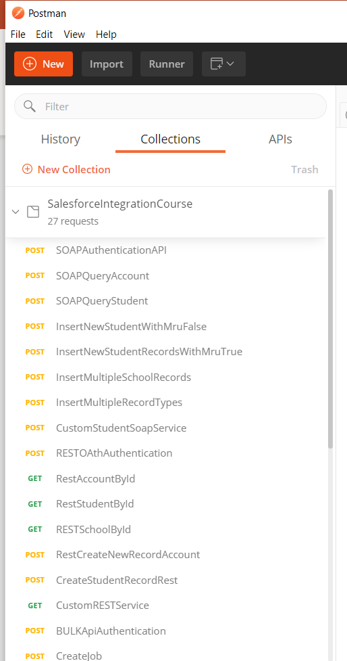
LEARN ABOUT SOAP UI & POSTMAN TOOL

Slide 9
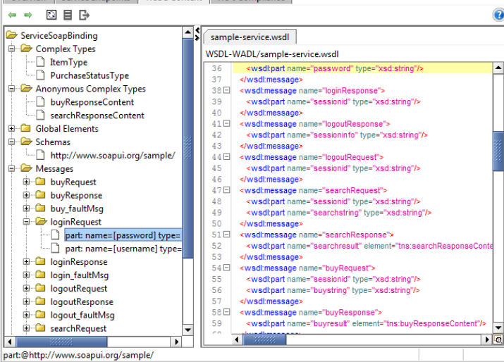
SOAP UI TOOL

Slide 10
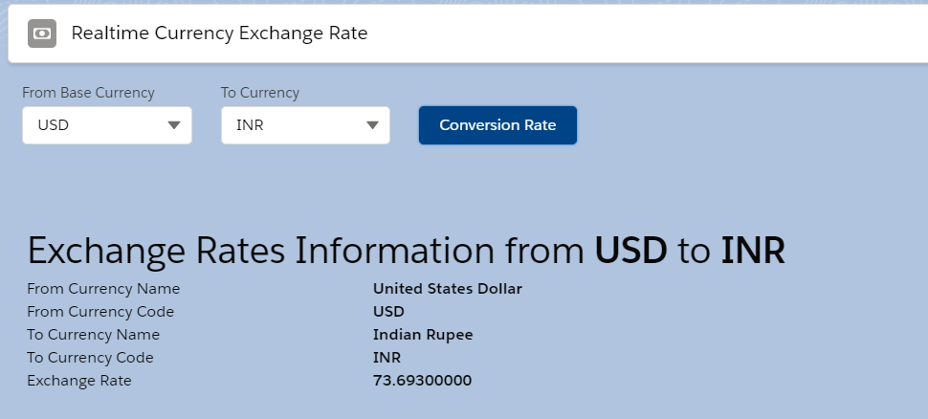
REST API Callout from LWC (Lightning Web Component)

Slide 11
Who this course is for?
Salesforce Developers who are interested to learn about integrating Salesforce with External Systems
Students who want to learn about different Salesforce API (SOAP | REST | Batch | Streaming | Outbound Messaging | Apex Callouts)
If you are looking to become a Senior Salesforce Developer, this course is for you.
If you are looking to pass your Salesforce Developer Certification II, this course is for you.
If you are a junior Salesforce developer and want to improve your skills to become a Senior developer, this course is for you.
If you are interested to learn about more advanced concepts in Salesforce Development, this course is for you.

Slide 12
How this course is different?
This course is Complete HANDS –ON training course which contains real-time project scenarios.
No such course available similar to this.
Important APIs are covered in this course i.e Streaming API, BULK API, REST API, SOAP API etc.
Real-time integration examples are covered in the course.

Slide 13
WEEKENDS DOUBTS SESSION
Every Saturday will be a LIVE Doubts session
Code Snippets are available in the course
Quizzes

Slide 14
enroll in the course
https://www.udemy.com/course/salesforce-integration-with-external-systems/?couponCode=INTEGRATIONCOURSE

Slide 15


